Slide 1
VIRTUAL CLOTHING SYSTEM

Slide 2
OBJECTIVE OF THE PROJECT
This project is aimed to provide a reliable solution for the users to choose the correct clothes by wearing it virtually .
This projects presents an unique body measurements for the person who measures their body to get right size clothes and get future clothes combinations prediction using AI and ML.
This project reduces time by having virtual trail instead of having a real trail for clothes .

Slide 3
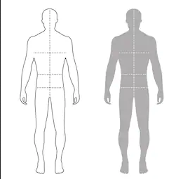

INTRODUCTION
This project detects the person chest, waist, inseam, etc., based on capturing images of the user .
Uses camera to capture the person height.
We going to proceed with 2 options one is scanning and another is without scanning.
The person who’s know their height , waist size , chest size etc ., no need for scan.
I II
With an outline of a silhouette , camera can capture the human body .

Slide 4
I : A request is made to the user to stand in a manner such that they fit approximately within the outline.
II : Side view is taken for measuring the side view of person .
After knowing all the sizes of the person , a 3d model will generate according to the measured size of the person .
So that we can wear and see the dressing of our character virtually.
With the help of machine learning when can recommend the user to dress up with their matching or suitable clothes .
User can ask help to ai/ml which clothes we should wear for an event or any occasion , so that ml will respond by recommending the user for best outfit.
Object can detect using Tensorflor.js and Three.js library is used for web 3d model generation .
BodyPix Algorithm used for measuring the segmentation of the parts of body .

Slide 5
PROJECT FEATURES
Measurement:
Easy way to measure the human body .
Can measure the size by their own and reduce time .
Virtual fitting room :
Can change their clothes virtually .
They can have a virtual trail on 3d character , no need for physical trail .
AI/ML:
The user can choose their suitable outfits with the help of recommendation of ML .
It will also predict the cloth size of the user .

Slide 6
APPLICATION OF THE PROJECT
This can be used for choosing the best combination for the clothes .
By using this application we can have a dress up trail virtually at home .
This application can be used in all Textile shops in future days .
It can recommend outfit for marriages or any events any predict recommend size of clothes using ai/ml .

Slide 7
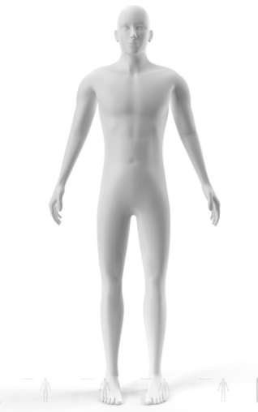
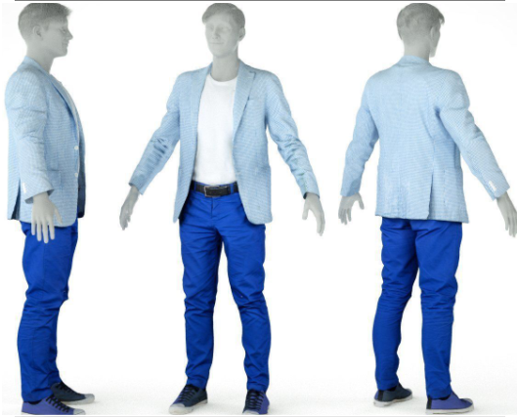
EXPECTED OUTCOME OF THE PROJECT
The final output expecting as a 3d model of user with perfect outfit virtually .

Slide 8
TECHNOLOGIES USED
Language:
Java Script
Server:
Node js
Frame Work:
React js
Libraries:
Tensorflow.js , Three.js , WebGL
Database:
Mango DB

Slide 9
REFERENCES
[Updated] BodyPix: Real-time Person Segmentation in the Browser with TensorFlow.js
Real-time Clothing size body measurement estimator using TensorFlow.js

